Slide 1
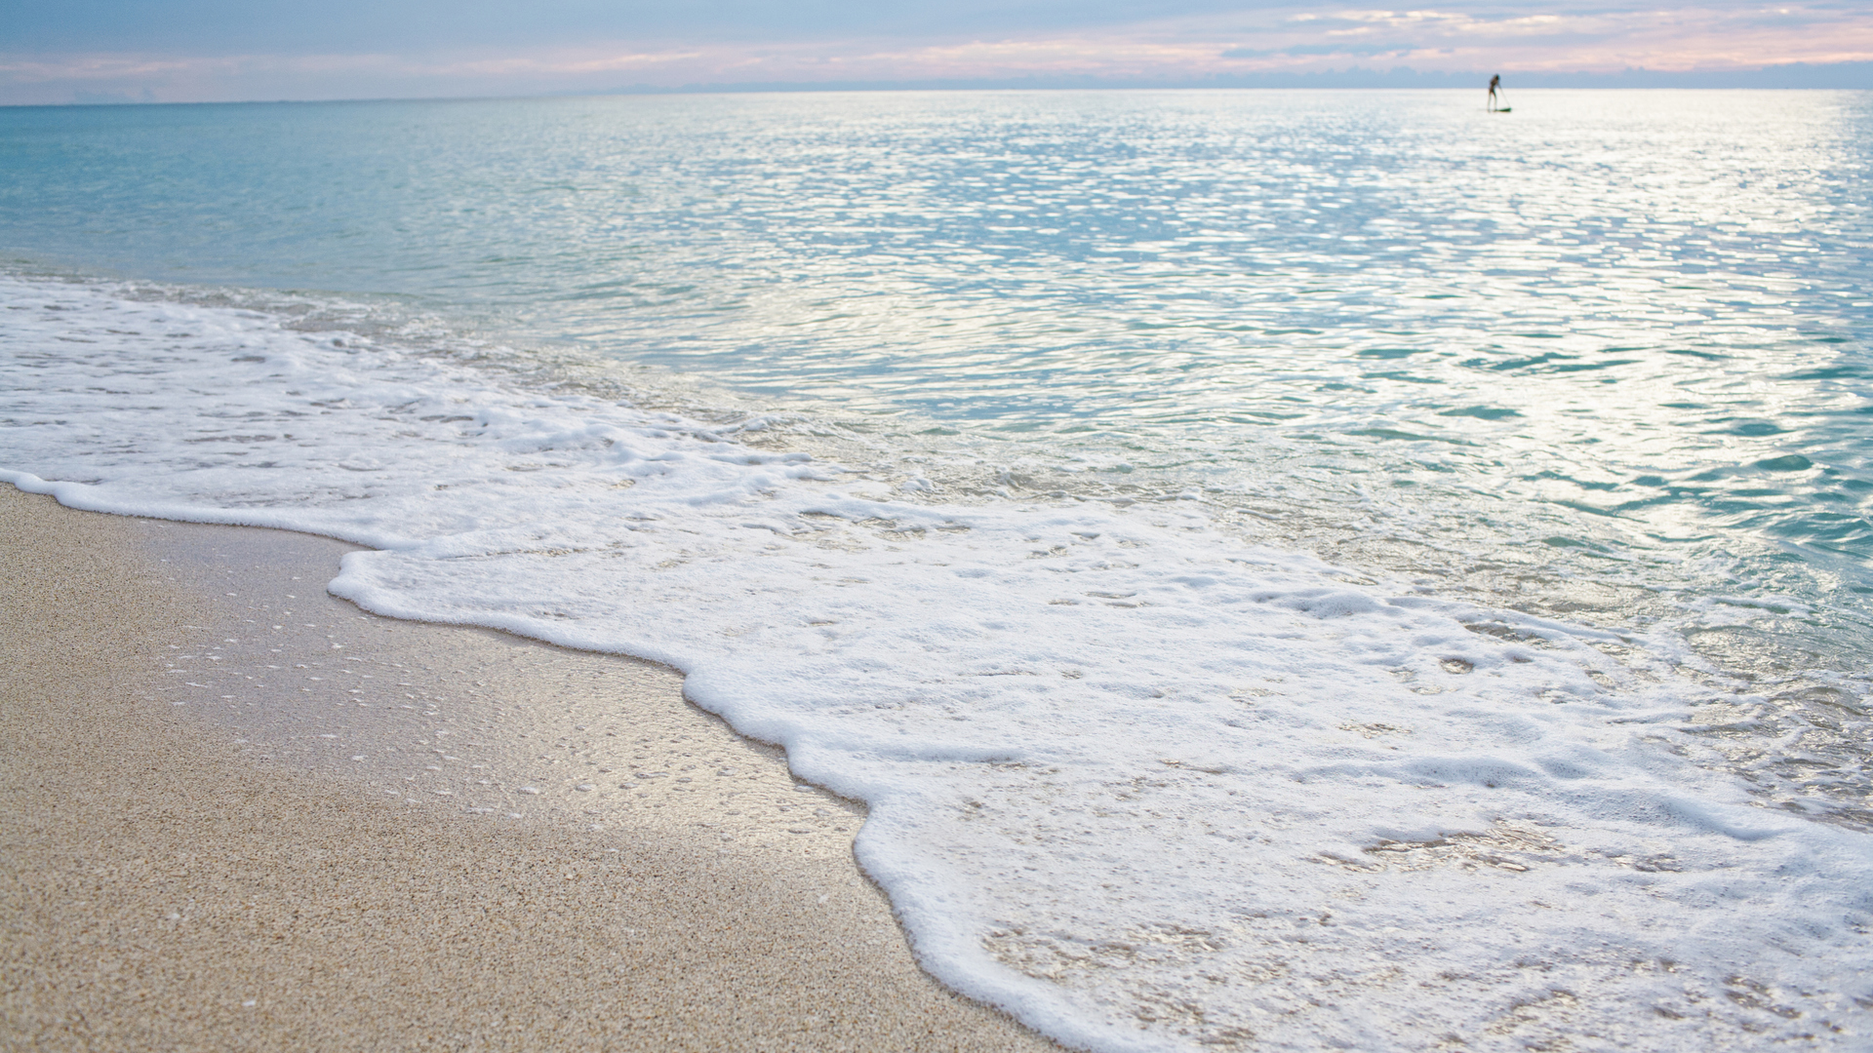
Quiz in Science 6

Slide 2
I. Read, understand and answer the following questions. Then, write the letter of your answer on a separate sheet of paper.
1. The rain starts to fall frequently. Farmers begin to plant their crops. People prefer to wear thick clothes and eat warm foods. What season do these events indicate?
A. spring season
B. winter season
C. dry season
D. wet season

Slide 3
I. Read, understand and answer the following questions. Then, write the letter of your answer on a separate sheet of paper.
2. Which season is characterized by frequent rainfall?
A. dry season
B. wet season
C. fall season
D. winter season

Slide 4
I. Read, understand and answer the following questions. Then, write the letter of your answer on a separate sheet of paper.
3. Which is characterized by infrequent rainfall and warm temperature?
A. wet season
B. fall season
C. dry season
D. winter season

Slide 5
I. Read, understand and answer the following questions. Then, write the letter of your answer on a separate sheet of paper.
4. Which are the causes of seasons being experienced by people on certain parts of the Earth?
A. the Earth’s rotation and shape
B. the Earth’s revolution and tilt on its axis
C. the Earth’s rotation and gravity
D. the continents and water bodies surrounding the place

Slide 6
I. Read, understand and answer the following questions. Then, write the letter of your answer on a separate sheet of paper.
5. This prevailing wind is warm and moist. It blows from the southwest portion of the country and brings moderate to heavy rains along the western section of the Philippines. What is it?
A. Trade winds
B. Hanging Amihan
C. Hanging Habagat
D. Northeast Monsoon

Slide 7
I. Read, understand and answer the following questions. Then, write the letter of your answer on a separate sheet of paper.
6. Which season takes place in the Philippines from December to May?
A. dry season
B. wet season
C. cold season
D. summer season

Slide 8
I. Read, understand and answer the following questions. Then, write the letter of your answer on a separate sheet of paper.
7. Which is also known as Hanging Amihan?
A. Eastwest Monsoon
B. Northeast Monsoon
C. Southwest Monsoon
D. Northsouth Monsoon

Slide 9
I. Read, understand and answer the following questions. Then, write the letter of your answer on a separate sheet of paper.
8. Which season in the Philippines is the best time for farmers to dry their crops?
A. Dry season
B. Wet season
C. Spring season
D. Autumn season

Slide 10
I. Read, understand and answer the following questions. Then, write the letter of your answer on a separate sheet of paper.
9. Which is influenced by the Northeast Monsoon?
A. wet season
B. dry season
C. winter season
D. summer season

Slide 11
I. Read, understand and answer the following questions. Then, write the letter of your answer on a separate sheet of paper.
10. Which can be experienced during wet season?
A. warm temperature
B. hot cloudless days
C. shortage of water supply
D. heavy rainfall and frequent typhoons

Slide 12
I. Read, understand and answer the following questions. Then, write the letter of your answer on a separate sheet of paper.
11. The Philippines experiences two seasons only because it is located near the _______.
A. equator
B. North Pole
C. South Pole
D. temperate Region

Slide 13
I. Read, understand and answer the following questions. Then, write the letter of your answer on a separate sheet of paper.
12. Which causes the seasons experienced in the Philippines?
A. people living in the country
B. oceans that surround the Philippines
C. continents near the Philippines
D. location of the Philippines near the equator

Slide 14
I. Read, understand and answer the following questions. Then, write the letter of your answer on a separate sheet of paper.
13. When is the best season for farmers to start planting their crops?
A. winter season
B. spring season
C. dry season
D. wet season

Slide 15

Part 2
Complete the sentences by supplying the missing words on the blanks. Choose your answers from the table. Write your answers on a separate sheet of paper.

Slide 16
The season in the Philippines that takes place during the months of December to May and is characterized by less rainfall is called ___.
The seasons in the Philippines are caused by its ______ and _____.

Slide 17
The prevailing wind that blows from the northeast portion of the country and causes slight to moderate rainfall in the eastern regions is called _______.
Less and infrequent rainfall during dry season leads to ______ that harms the animals and plants.

Slide 18
The prevailing wind that blows from the southwest portion of the country and causes heavy rainfall in the western regions is called _______.
The season in the Philippines that takes place during the months June to November and is characterized by frequent rainfall is called _______.

Slide 19
Frequent and heavy rainfall during wet season sometimes results to _______.

